Slide 1
OT Security Assessment & Analysis Sample Report
Notes:
This briefing pack will describe at a high level approach to assisting clients address the Operational Technology (OT) and Internet of Things (IoT) security challenge.

Slide 2
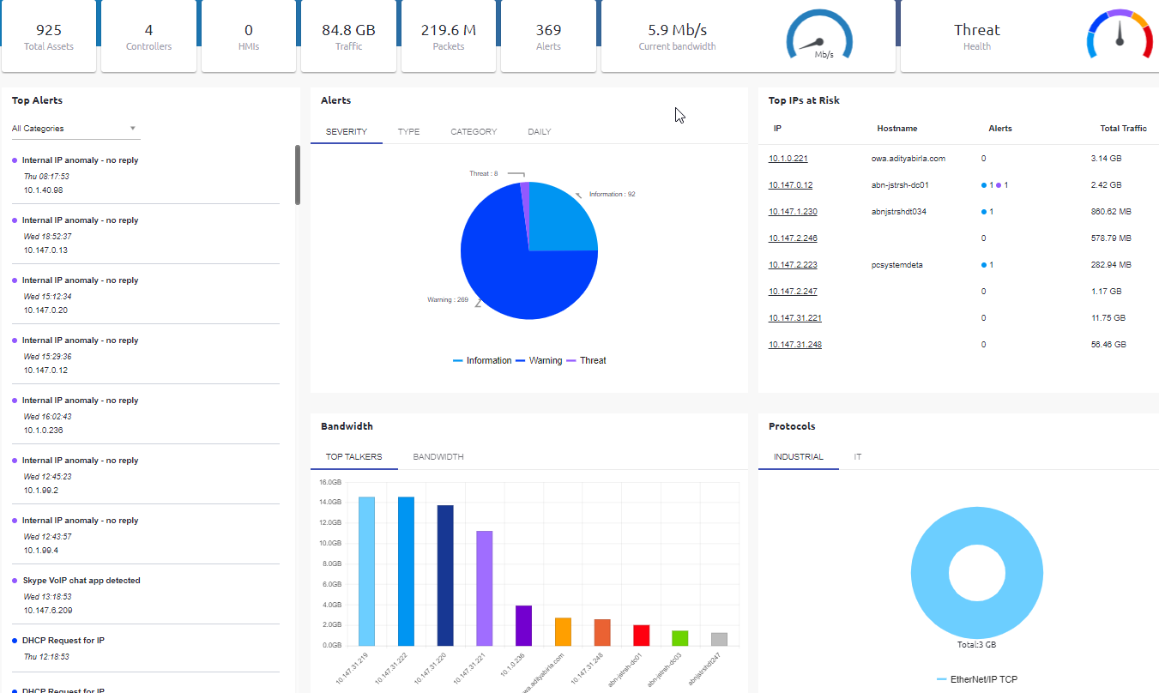
Activity Summary
PCAP files based analysis
85GB of traffic
Discovered 925 devices
Avg. traffic ~6 Mb/s

Slide 3
Executive Summary – Main Findings
Item | System’s Findings
Asset Inventory | A total of 925 devices were automatically discovered, including PLCs, IP cameras and servers.
Anomaly and threat detection | Internet connection & Remote Control applications Internet-connected Industrial asset (Rockwell) Multiple scanning attempts PLC not responding
Vulnerability detection | Default SNMP password Unsecure protocols: Telnet and HTTP SMBv1 (WannaCry vulnerability) Multihomed device risk Skype application Windows XP is in use
PLC/Software Vulnerabilities | Available using passive mode (requires software versions to be seen in network) or Active Mode (polling)
Network Architecture Security Review | Using Exposure Analysis tool – requires a 1-hour meeting w/ customer for review.

Slide 4
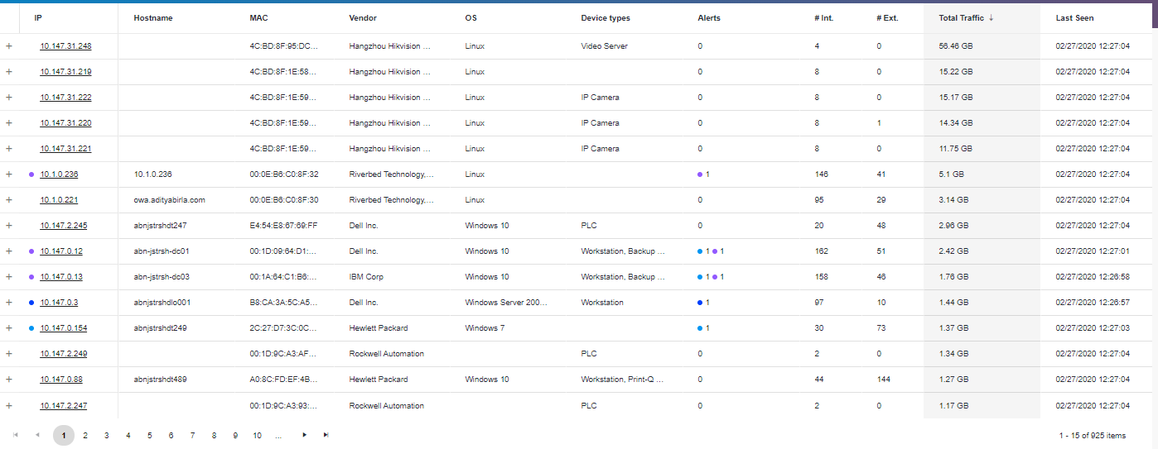
Automatic Asset Inventory and Management

Slide 5
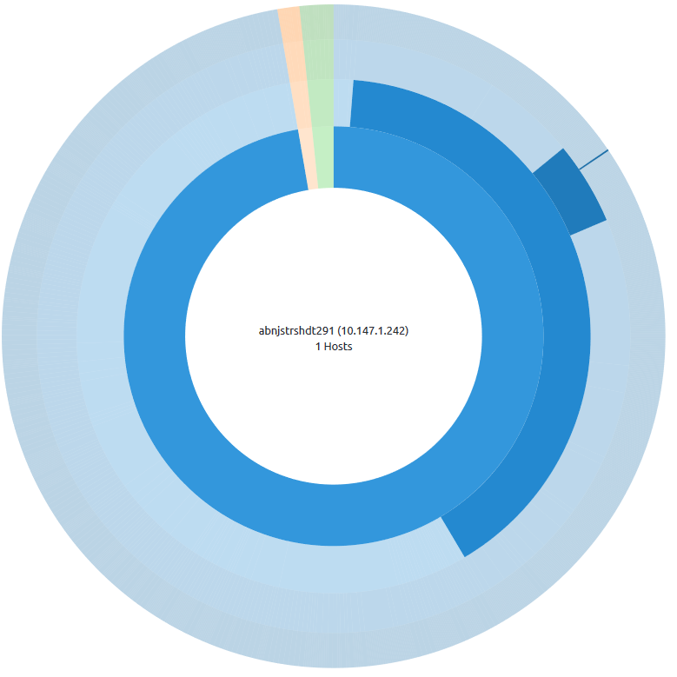
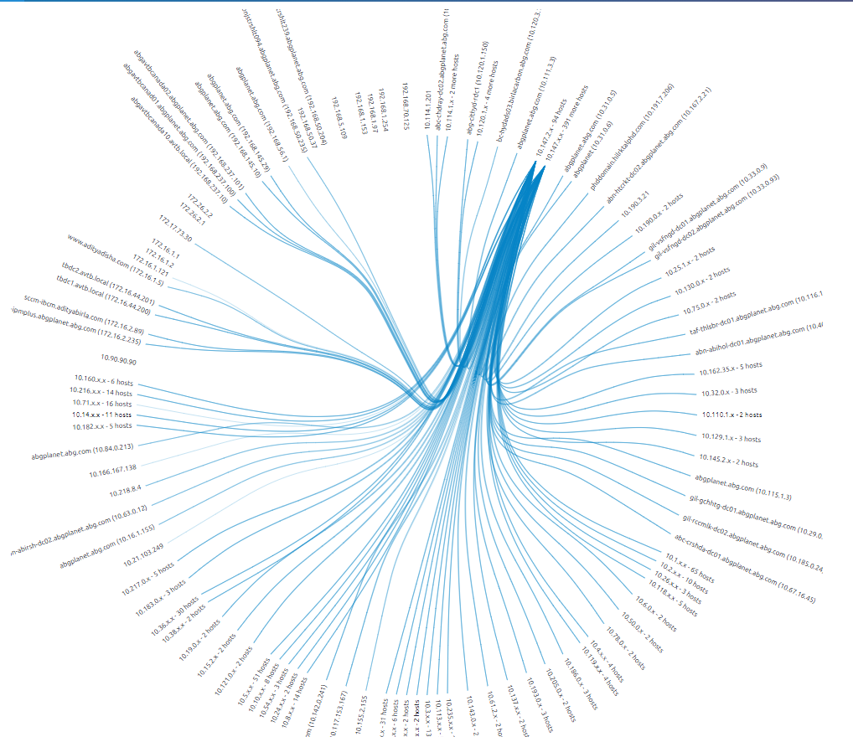
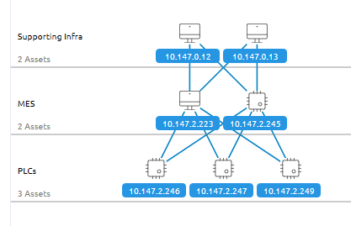
Network Architecture Mapping
Subnet Topology
Logical Topology
Physical Network View

Slide 6
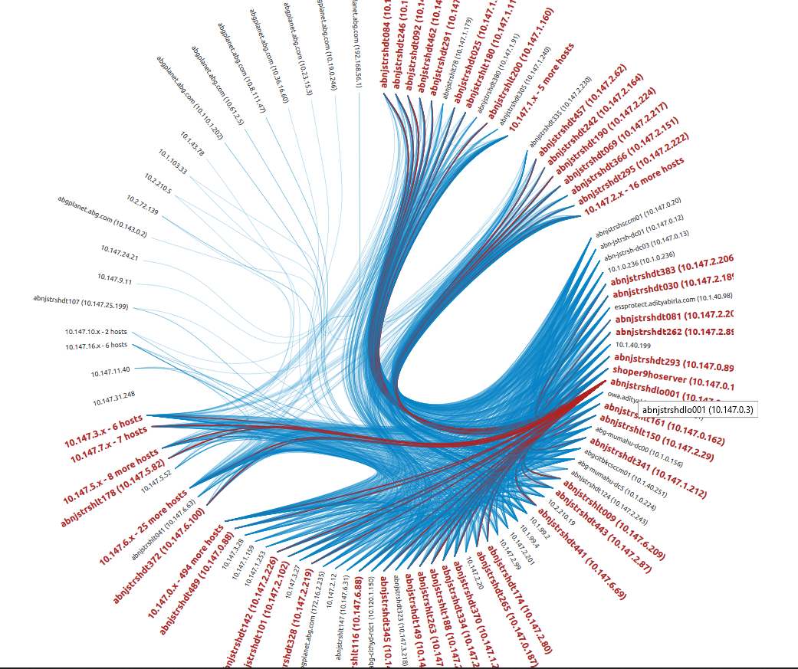
Network Architecture Conclusions
The network is highly connected as a result of:
Default discovery protocols that were left on
LDAP
Misconfigured/scanning applications
15540/TCP (“essprotect”)
NTP
The current network design isn’t clear
Conclusion: a 1-hour network architecture review w/ the customer is required in order to define Exposure Groups and analyze the findings.

Slide 7
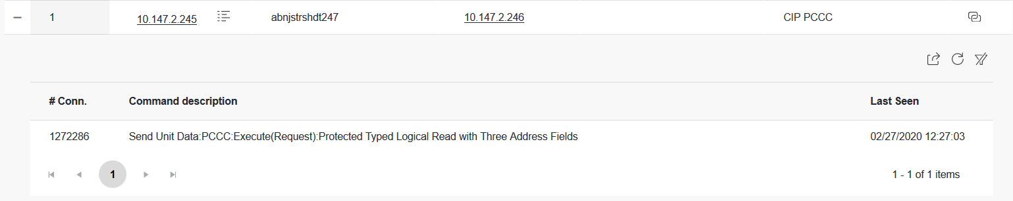
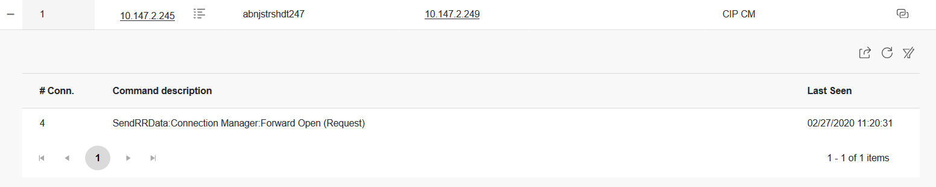
Industrial Protocol Visibility & Security

Slide 8
Major Findings

Slide 9
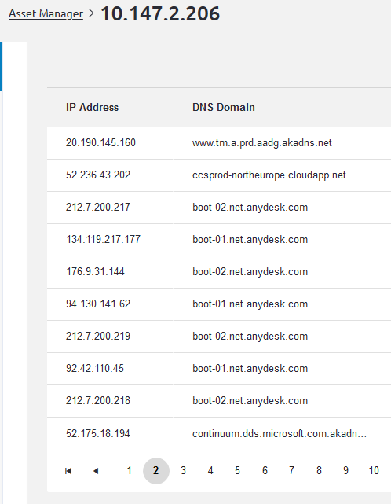
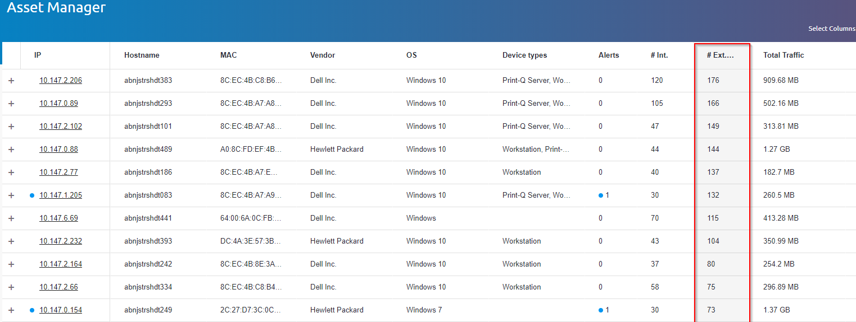
Finding #1 – Internet Connections & Remote Control (AnyDesk)
AnyDesk Remote Control
Many hosts have external connections to the Internet.
Risk – Exposing the OT network to internet threats and malware.
# External Connections

Slide 10
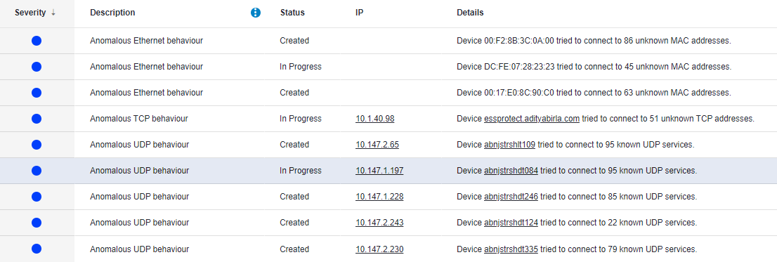
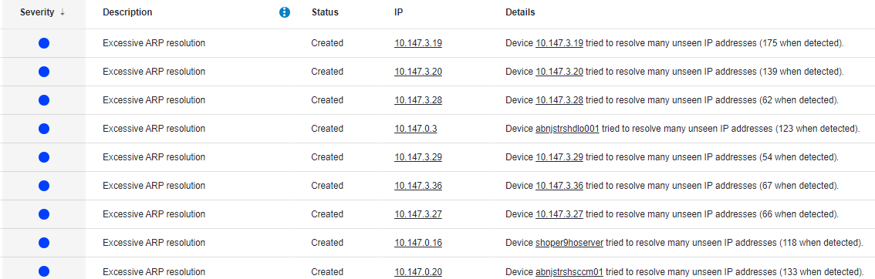
Finding #2 –Multiple scanning attempts
Multiple hosts were seen scanning the network.
Risk – Indicates a misconfiguration (automated discovery of network services). Can cause industrial devices to stop responding.
Example - Some industrial devices pose a limit on the number of open sockets. When scanned, the limit is exhausted, and device connectivity is disrupted.

Slide 11
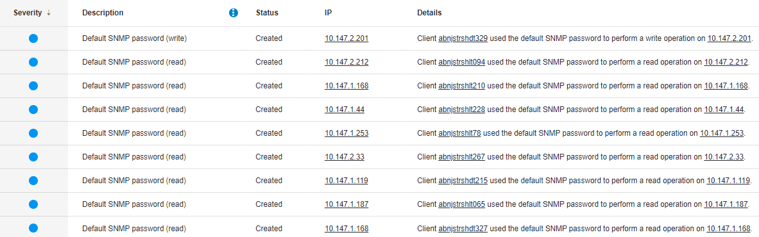
Finding #3 – Default SNMP password
Hosts using the default SNMP password to perform read and write operations.
Risk – Attackers or malware may use default credentials to read or modify device configurations.

Slide 12
Finding #4 – Unsecure Protocols
Unsecure plaintext protocols are in use.
Risk: Password theft, man-in-the-middle.

Slide 13
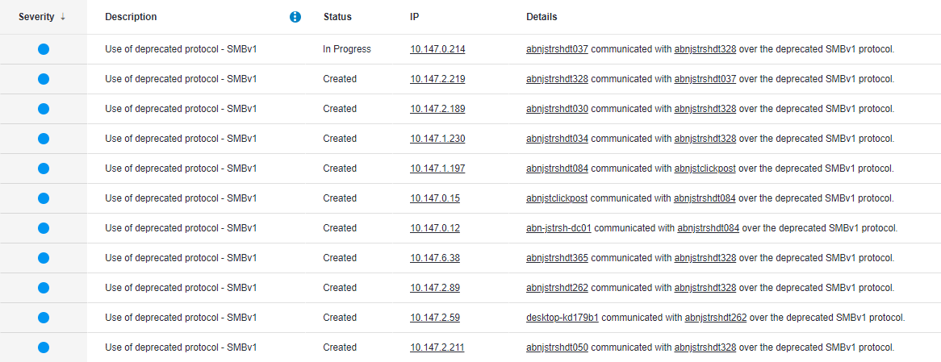
Finding #5 - SMB version 1
Legacy version of SMB is in use.
Risk: WannaCry and other malware infection.

Slide 14
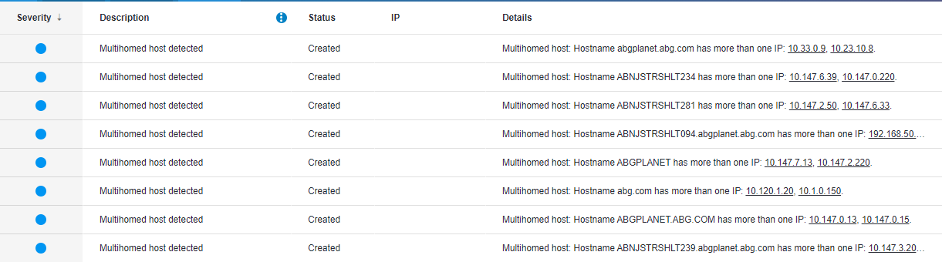
Finding #6 – Multihomed device risk
Multiple devices using more than one network interface.
Risk: Firewall bypass, malware propagation between network segments.

Slide 15
Finding #7– Skype Application
The Microsoft Skype application was detected on a workstation.
Risk: The application might give remote control over the computer, consume significant bandwidth, or allow users to transfer files in an unmonitored manner.
Example of a Skype Vulnerability

Slide 16
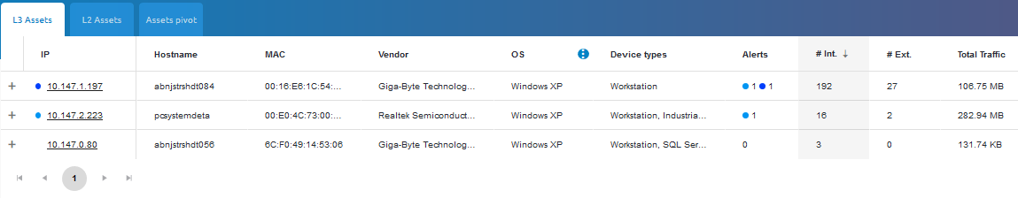
Finding #8– Windows XP is in Use
Windows XP has been detected in the network.
Risk: Windows XP is no longer supported by Microsoft, which exposes it to cyber attacks.

Slide 17
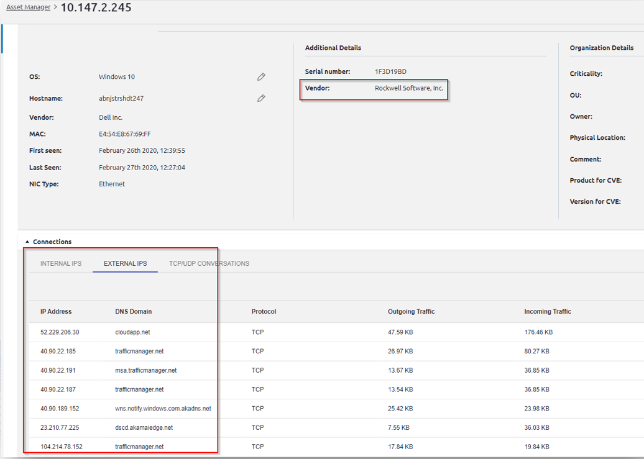
Finding #9– Internet-Connected Industrial Asset
A Rockwell industrial device is communicating with the Internet.
Risk: Malicious traffic originating from the internet may impact the device and result in severe consequences to production processes.

Slide 18
Finding #10 – PLC Not Responding
A service on a PLC did not respond to a request by a workstation.
Risk: Disruption to production process or production monitoring.

Slide 19
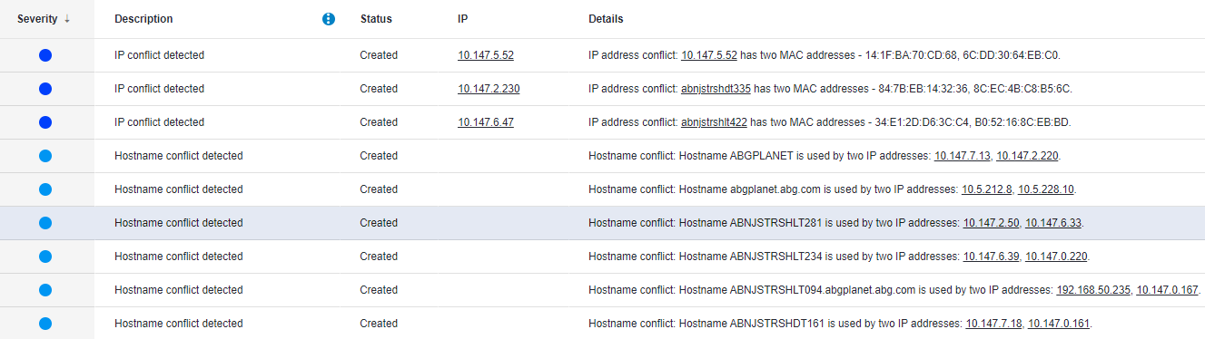
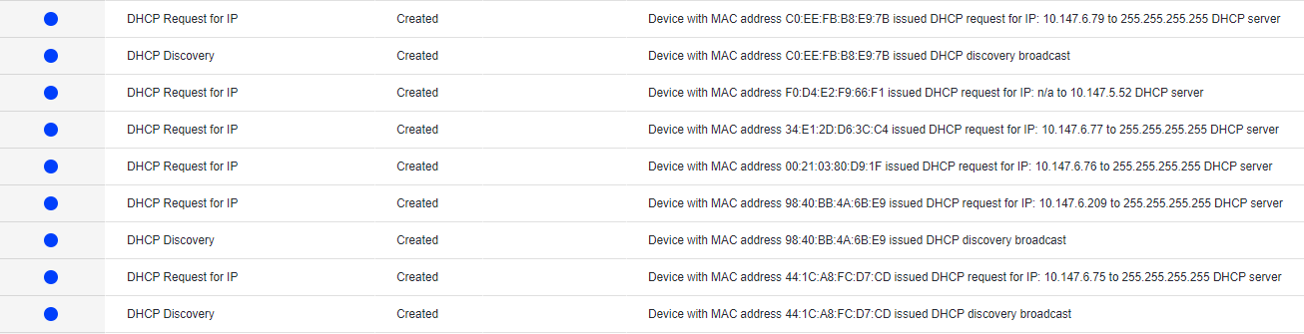
Additional Findings
Hostname and IP conflicts
DHCP misconfiguration

Slide 20
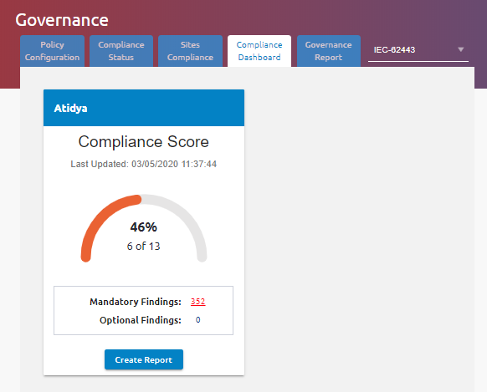





IEC 62443 Compliance
Per site risk scoring and trends over time
Per site detailed compliance reports
Based on actual network traffic
Client Site 1

Slide 21
System Analysis Conclusions
Not everything can be fixed
OT networks have security limitations: difficulty patching, insecure protocols, etc.
Therefore: Real-time malware and anomaly detection is critical to prevent incidents.
The network is dynamic and highly connected
High probability of new risks appearing over time.
Therefore: Real-time risk reporting is important to maintain reasonable risk levels.

Slide 22
Recommended Next Steps
Define security best-practices
Access control, protocols usage, password policy, and more.
Deploy industrial cyber management platform
Incident detection & vulnerability management
Network architecture review using Exposure Analysis tool
Establish incident handling process
Establish central governance to adhere to organizational cyber security policy

